Slide 1

Face recognition
What is face recognition?
deeplearning.ai

Slide 2
Face recognition
https://www.youtube.com/watch?v=wr4rx0Spihs
[Courtesy of Baidu]

Slide 3
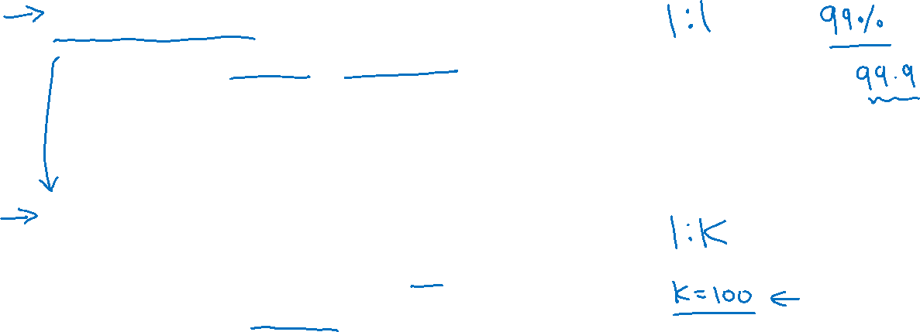
Face verification vs. face recognition
Verification
Input image, name/ID
Output whether the input image is that of the claimed person
Recognition
Has a database of K persons
Get an input image
Output ID if the image is any of the K persons (or “not recognized”)

